Slide 1
Impact of dam building and mining on environment
Mining:- Mining operation for extracting minerals and fossil fuels like coal often involves vast forest areas. Mining from shallow deposit is done by surface mining while that from deep deposit is done by sub-surface mining. This method is more destructive, dangerous and expensive including risks of occupational hazards and accident
More than 80,000 ha. Of land of the country is presently under the stress of mining activities.
Mining and its associated activities require removal of vegetation along with underlying soil and overlying rock masses.
This result in defacing the topography and destruction of the landscape in the area.

Slide 2
Types of mining
Types
Surface mining
Open pit mining
Dredging
Sub-surface mining
Strip mining

Slide 3
Open-pit mining:- In which machines dig holes and remove the ores (e.g. copper, iron, gravel, sandstone, marble, granite).
Dredging:- (Bring up or clear something) In which chained buckets(is a heavy equipment machine used in surface mining) and draglines are used which scrap up the minerals from under water mineral deposits.
Strip mining:- In which the ore is stripped off by using bulldozers and stripping wheels.

Slide 4
Impact of mining
Devegetation and defacing of landscape
Subsidence of land
Groundwater contamination
Surface water pollution
Air pollution
Occupational health hazards
Large scale deforestation has been reported in Mussorie and Dehradun valley due to indiscriminate mining of various minerals over a length of about 40 km. The forested area has been declined at an average of 33% and the increase in non-forest area due to mining activities has resulted in relatively unstable zones leading to landslides.

Slide 5
Indiscriminate mining in forest of Goa since 1961 has destroyed more than 50,000 ha of forest land.
Coal mining in Jharia, Raniganj, and singrauli area have caused extensive deforestation in Jharkhand.
Mining of radioactive minerals in Kerala, Tamil Nadu and Karnataka is posing similar threats of deforestation.
The rich forests of western ghats are also facing the same threats due to mining project.

Slide 6
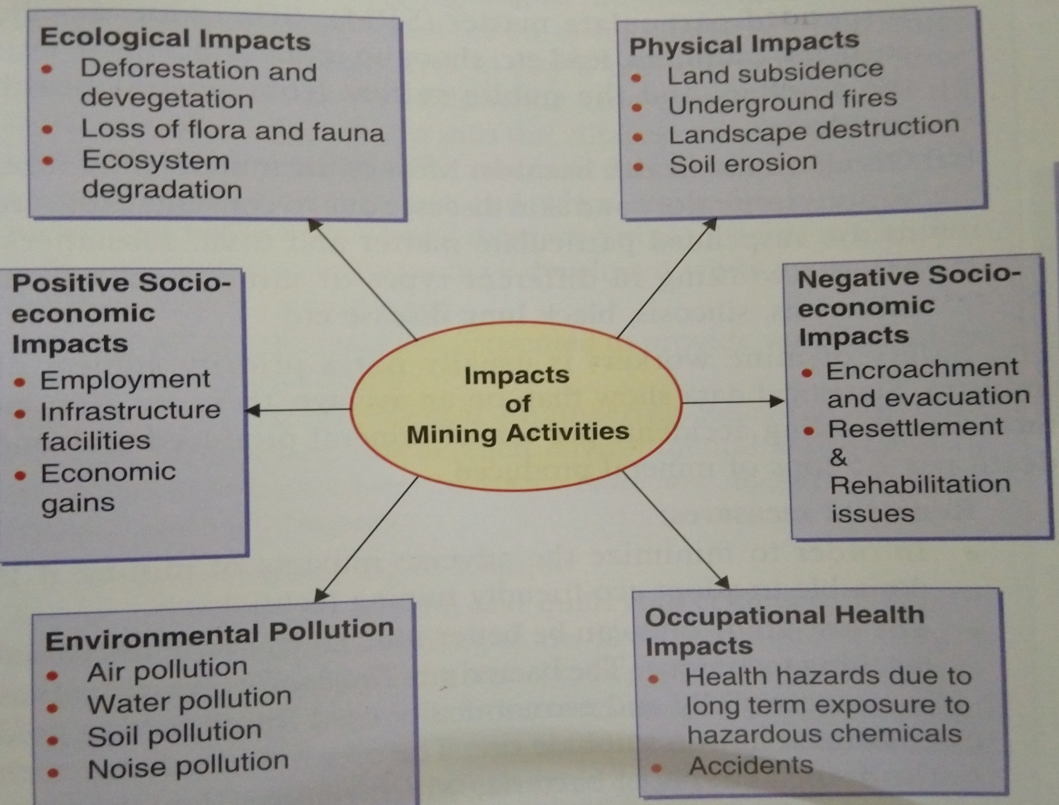

Slide 7
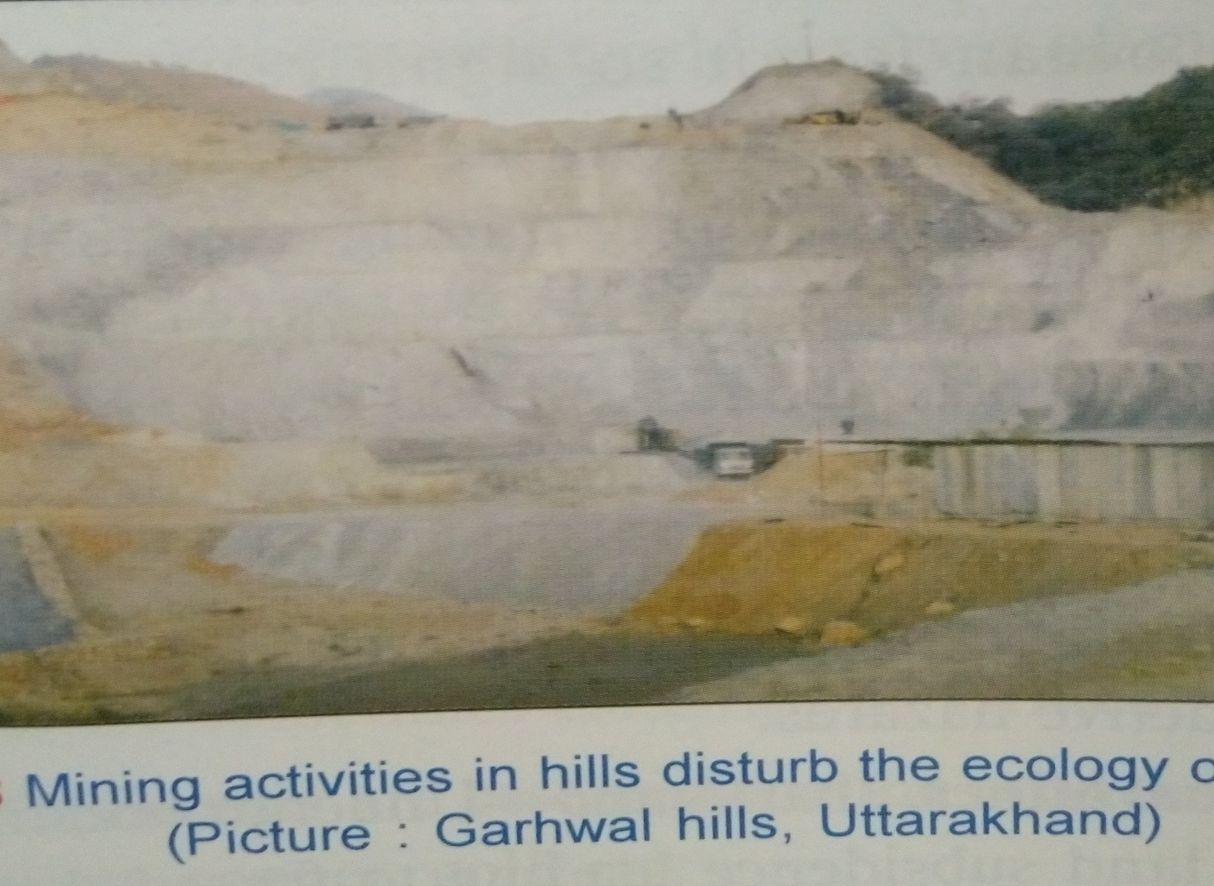

Slide 8
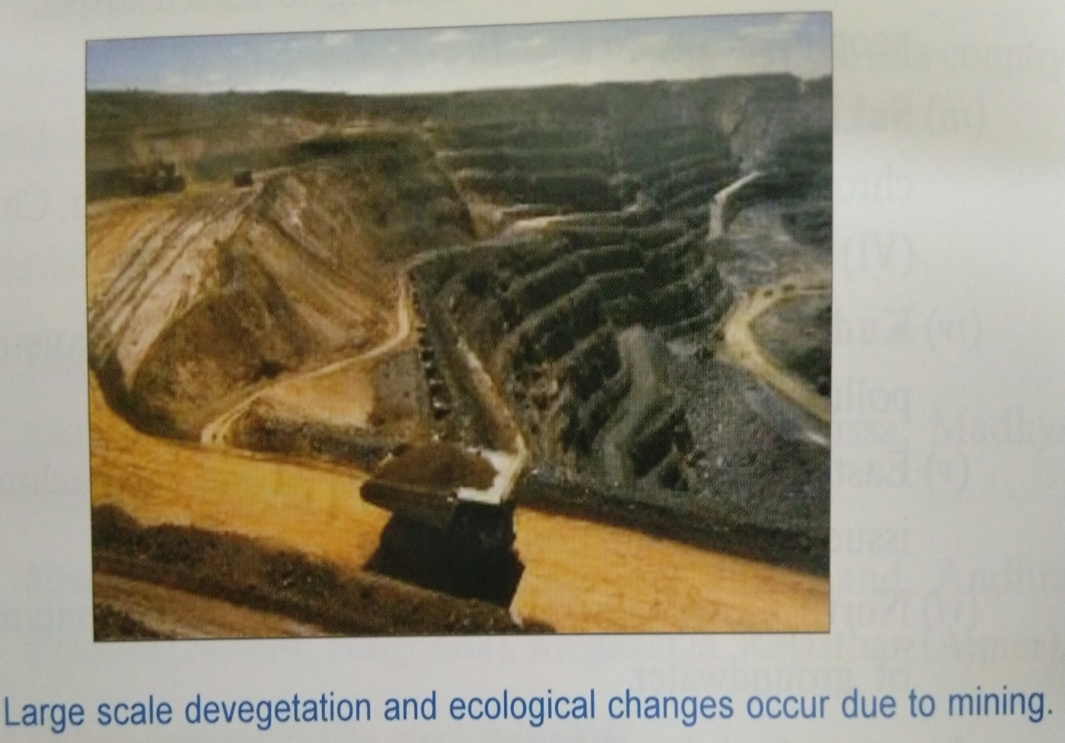

Slide 9
Dam and their effects on Forests and people
Big dam are often regarded as a symbol of national development. Big dam and river valley projects have multi-purpose uses and have been referred to as “Temples of modern India”.
However, these dams are also responsible for the destruction of vast areas of forest.
India has more than 1550 large dams, the maximum being in the state of Maharashtra (more than 600), followed by Gujarat (more than 250) and Madhya Pradesh (130).
The highest dam is Tehri dam, on river Bhagirathi in Uttarakhand and the largest in terms of capacity is Bhakra dam on river Satluj in Himachal Pradesh.

Slide 10
Big dams have been in sharp focus of various groups all over the world which is mainly because of several ecological problems including deforestation and socio-economic problems related to tribal or native people associated with them.
For building big dams, large scale devastation of forests takes place which breaks the natural ecological balance of the region. Floods, droughts and landslides become more prevalent in such areas.
Forests are the valuable gifts of nature in the form of biodiversity and destroying them.

Slide 11
Environmental problems
The environmental impacts of big dams are also too many due to which very often the big dams become a subject of controversy. The impact can be at the upstream as well as downstream levels.
The up stream problems:-
Displacement of tribal people
Loss of forests, flora and fauna
Siltation and sedimentation of reservoirs
Reservoir induced seismicity causing earthquakes
Microclimatic change
Lose of non-forest land

Slide 12
The downstream impacts:-
Water logging and salinity due to over irrigation
Reduced water flow and silt deposition in river
Flash floods
Loss of land fertility along the river since the sediments
Outbreak of vector-borne diseases like malaria

Slide 13
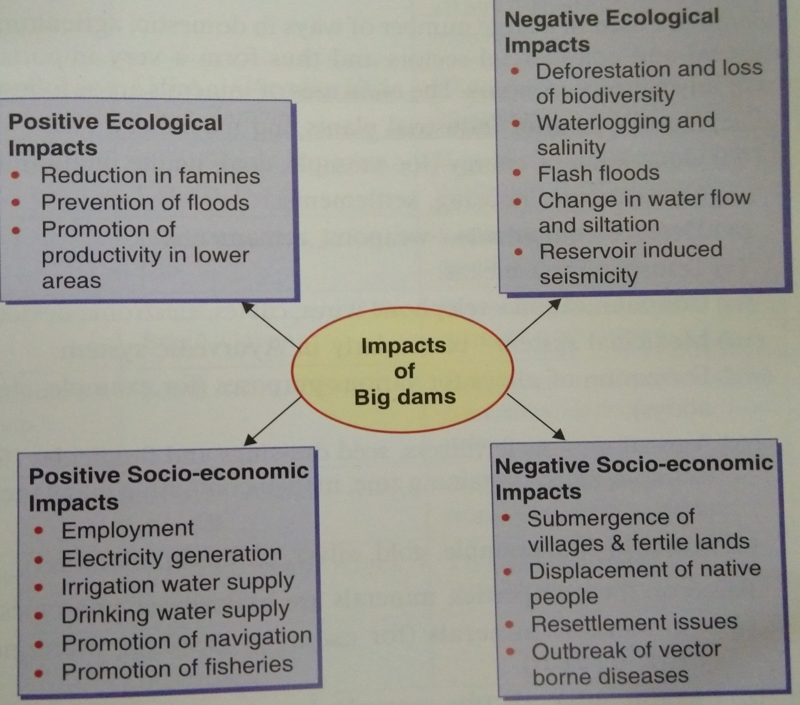

Slide 14
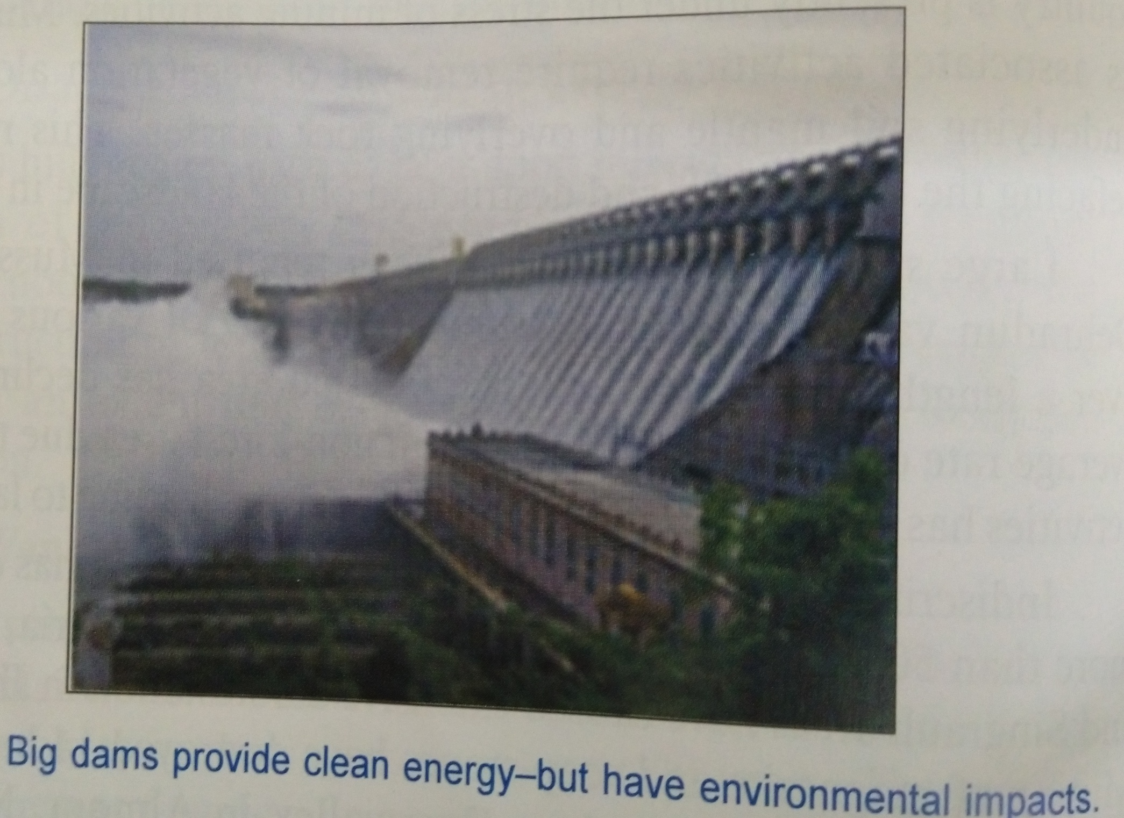

Slide 15


Slide 16
Effects of deforestation on biodiversity
The results revealed that deforestation has negative impact on biodiversity in the area. The impact of deforestation on biodiversity seen in terms of loss of valuable plant species, reduced plant biomes and extinction of species.
Loss of habitats
Illegal wild life trade
Global climate change

Slide 17
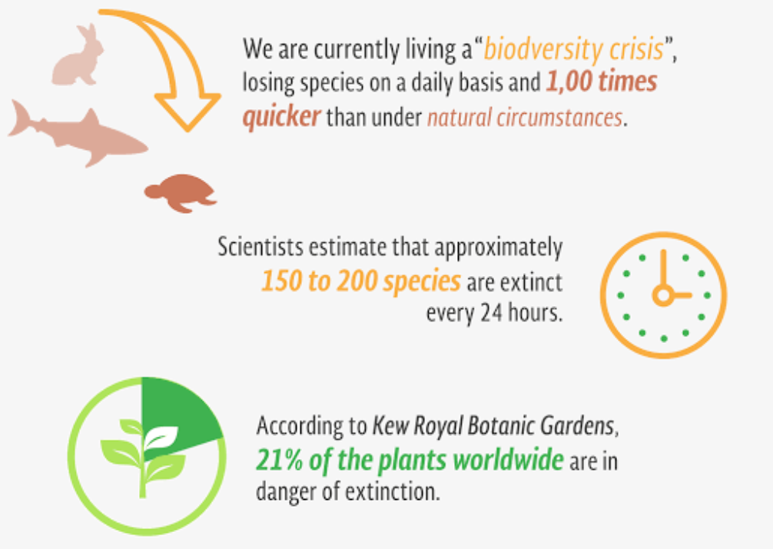
Biodiversity loss

Slide 18
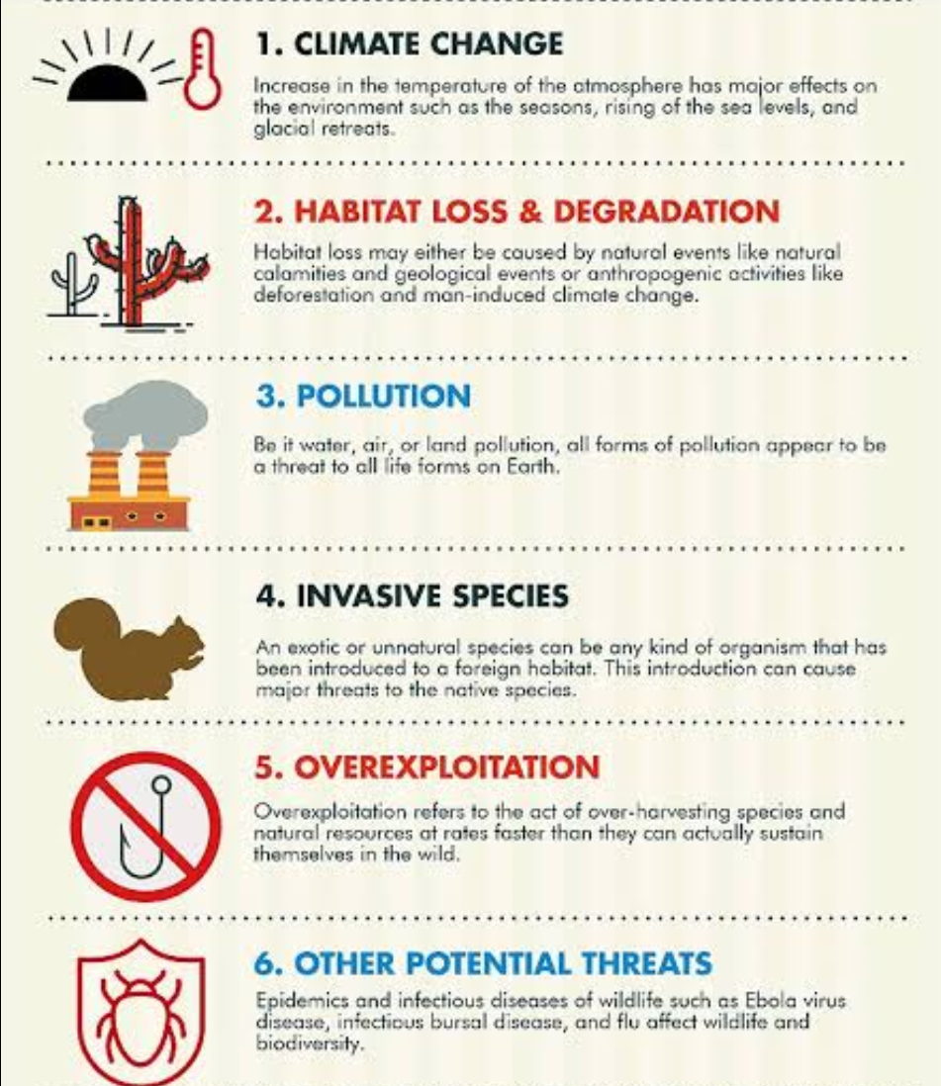

Slide 19
Effects of deforestation on tribal people
Forest have played a vital role in the socio-economic and cultural life of the tribal people if India.
It is well known that majority of the tribal population lived in isolation in the forested regions of India with harmony, security and trust for many centuries and developed a symbiotic relationship with forest.
The loss of tree and other vegetation can cause climate change, desertification, soil erosion, crops problem, flooding increased green house gases in the atmosphere and a host of problem for indigenous people.

